Slide 1
MESSENGER PLATFORM
WEB CHATBOT PROJECT
Auth: Khiem Tran

Slide 2


CONTENT
CHATBOT
What is it?
Why do people use chatbot?
How to create a chatbot?
MESSENGER PLATFORM
Why Messenger Platform and brief of history
M.P Core components
Pros and Cons

Slide 3

What is chat bot?

Slide 4
What is a chatbot?
A computer Program
Able to simulate a conversation (chat) with user in Natural language

Slide 5
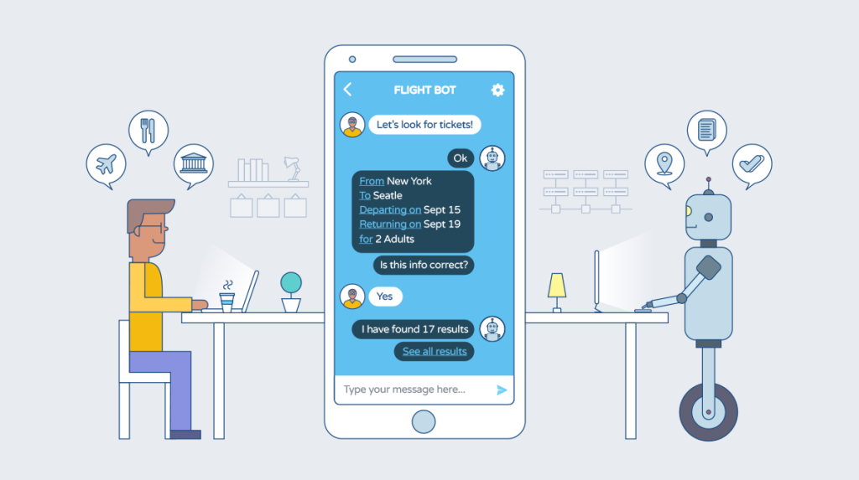
Why do people use chat bot?

Slide 6
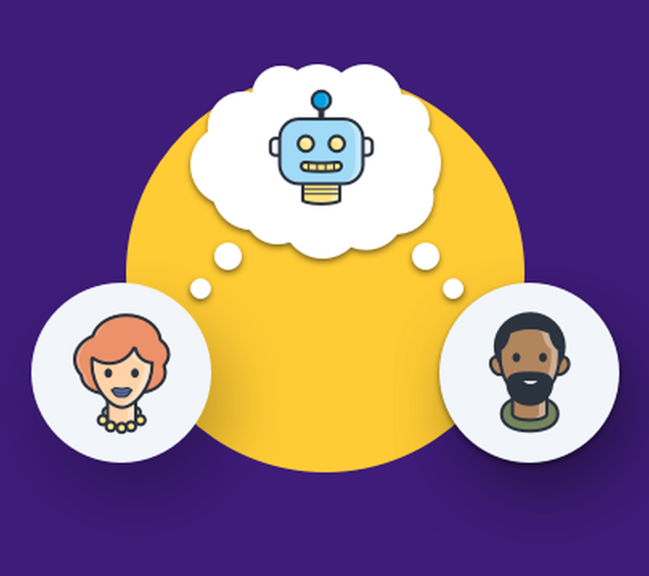
Why do people use chatbot?
Everyone uses it
Effective
Reduce cost paying for employee

Slide 7

How to create a chatbot?

Slide 8



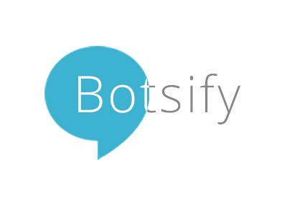
How to create a chatbot?
Platform
Chatfuel
FlowXO
Motion.ai
Botsify
WotNot
Documents and online tutorials available and easy to access
A lot of Platform and API for build your bot

Slide 9


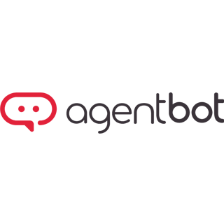

How to create a chatbot?
APIs
API.ai
Msg.ai
Reply.ai
Luis.ai
Twyla
AgentBot
PypeStream
Documents and online tutorials available and easy to access
A lot of Platform and API for build your bot

Slide 10
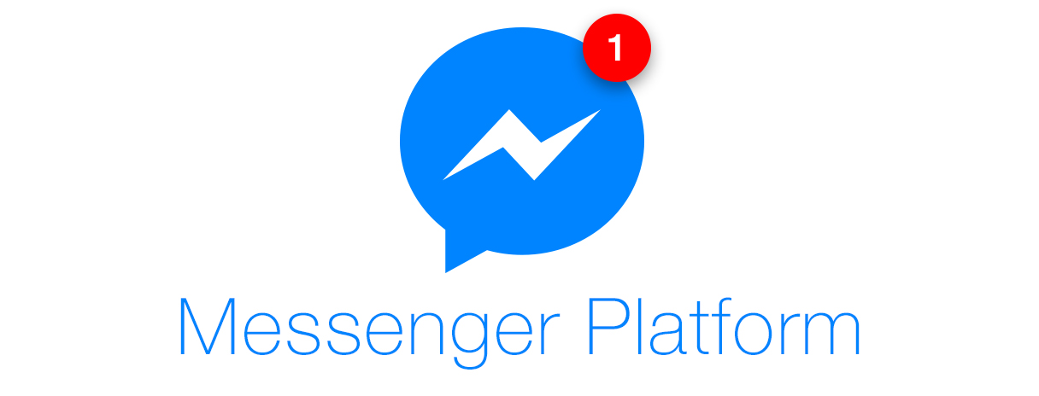

Slide 11

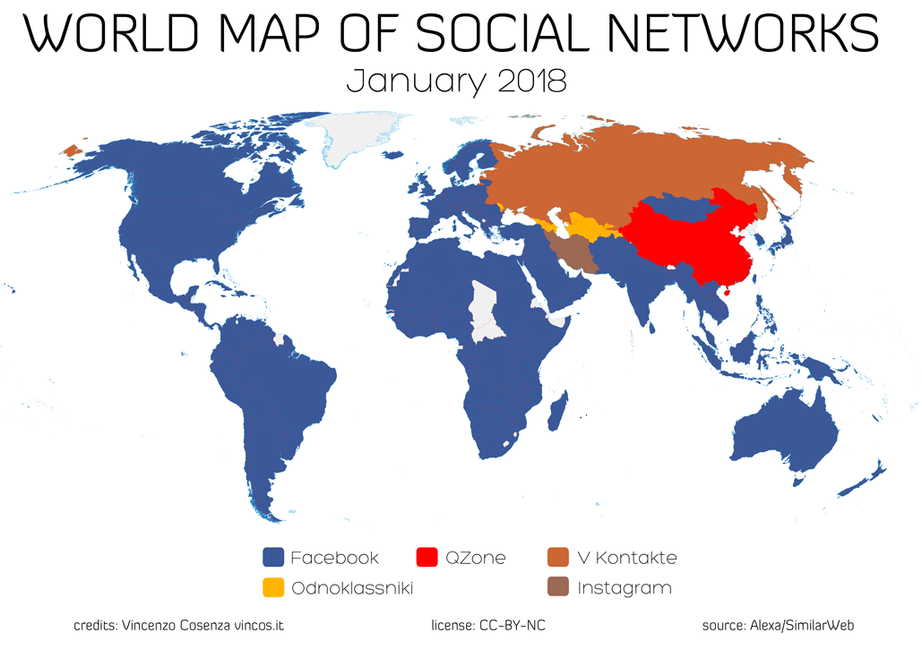
Why Messenger Platform and
Brief of history
First launch in April 2008
…
Bot Platform feature added in April 2016
Bots in group chats, Chat extensions and QR scan available from 2017
No.3
Alexa Global website ranking
Feb 2019
30K⁺
Employee
Jun 2018
2.3B⁺
Monthly active user Dec 2018

Slide 12
CORE COMPONENTS
Page-Scoped ID
The Messenger Platform is comprised of a set of features intended to give you everything you need to create awesome, interactive experiences in Messenger, including APIs, web plug-ins, and a full webview.
Plug-ins
APIs
Messenger
Platform
Chatbot
Built-in NLP
Webhook
Extensions
Webview

Slide 13
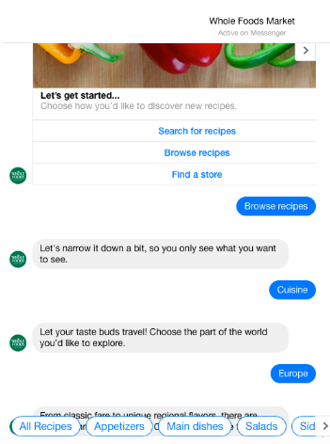
Page-Scoped IDs is used to identify a USER to a BOT conversation
Specific ID of an USER to a specific BOT
Unique to Facebook page and cannot be used in any other FB page.
PSID is always included in any action or message via recipient.id or sender.id (webhook event's property).

Slide 14





APIs
Identity is central to creating a great, personalized Messenger experience.

Slide 15
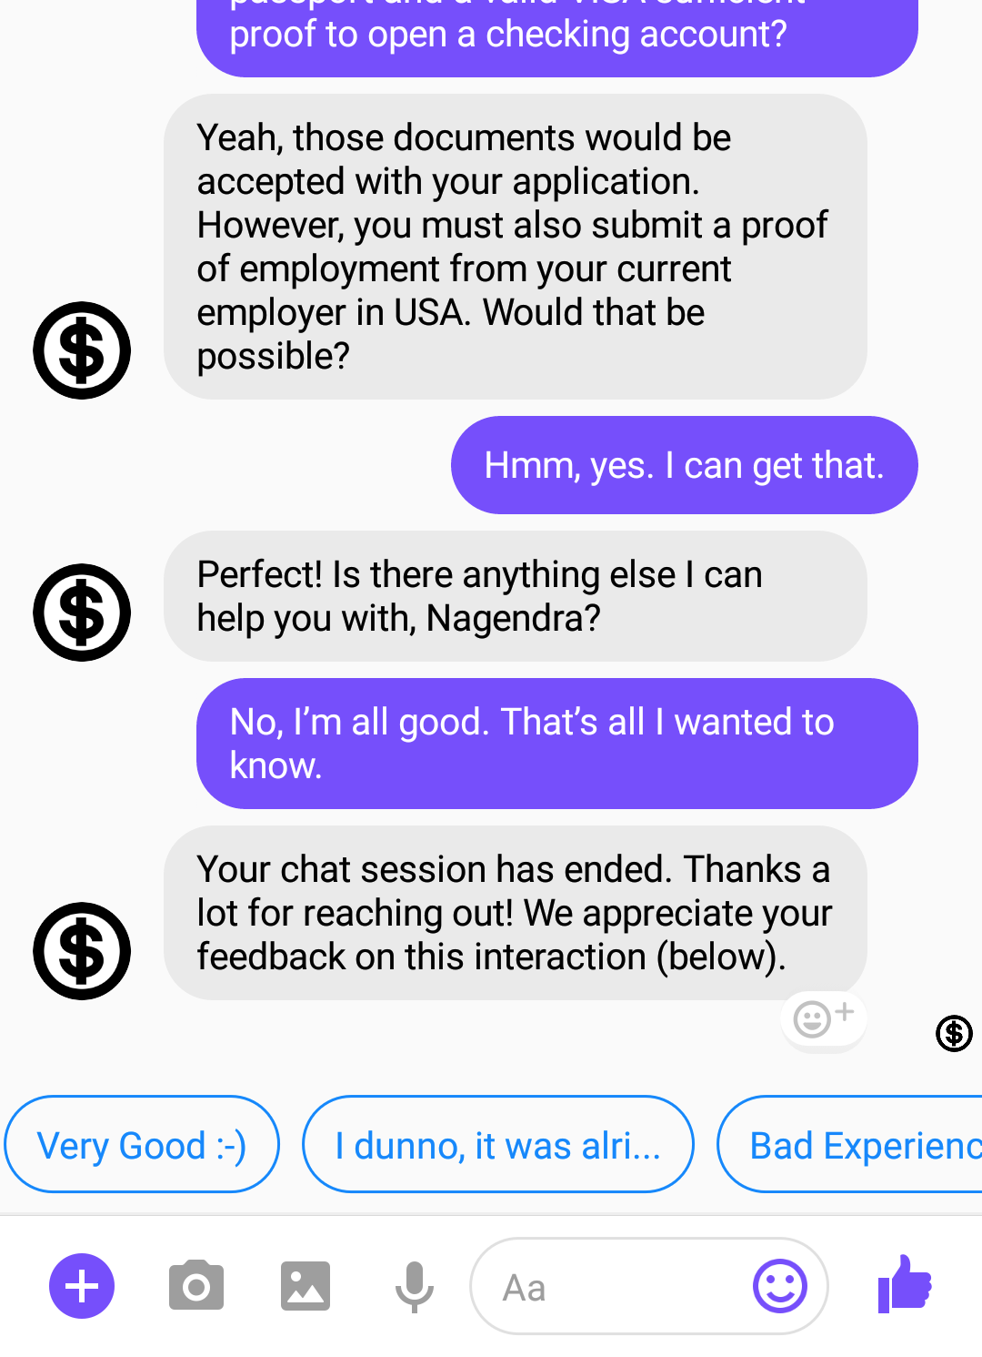
Webhook
The Messenger Platform sends events to your webhook to notify your bot when a variety of interactions or events happen including when a person sends a message.

Slide 16
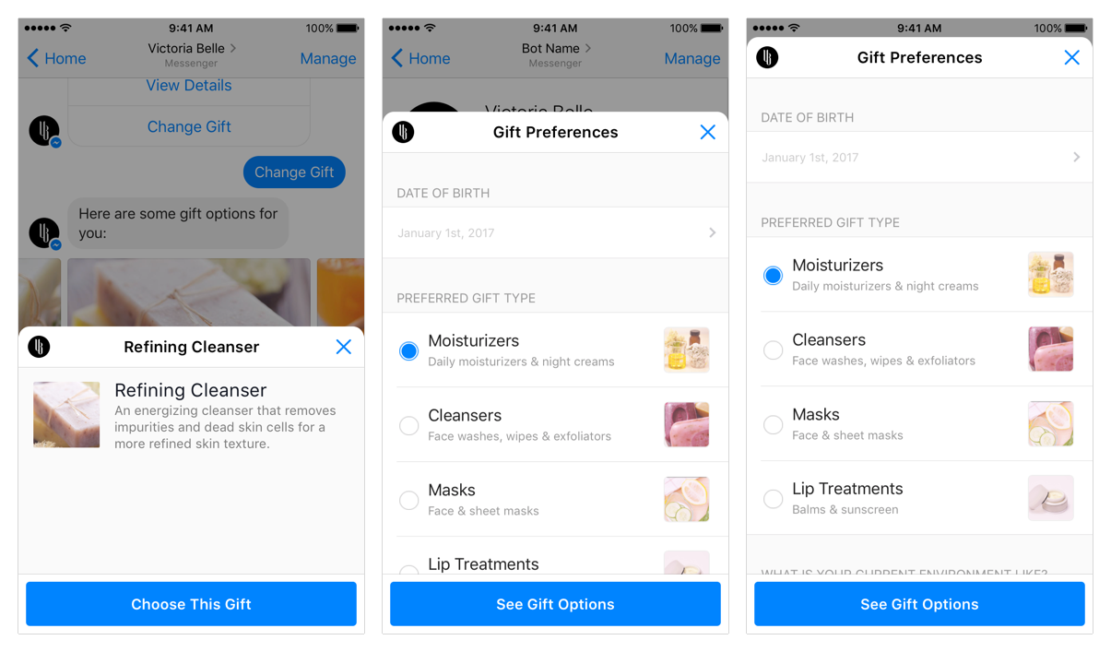
Webview
The Messenger Platform allows you to open a standard webview, where you can load webpages inside Messenger.

Slide 17
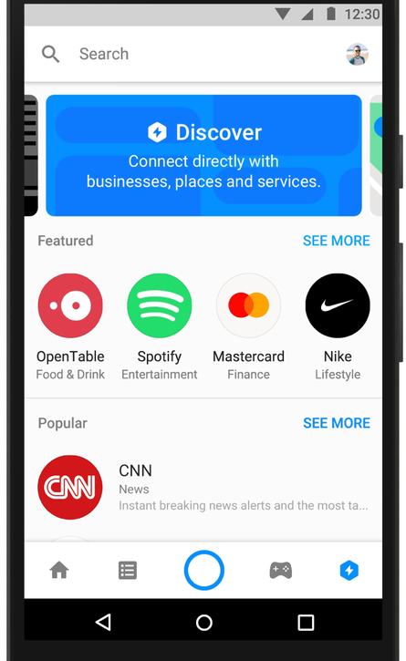
Extensions
Chat Extensions lets bots provide interactive, social features that users can invoke directly into their conversations.

Slide 18
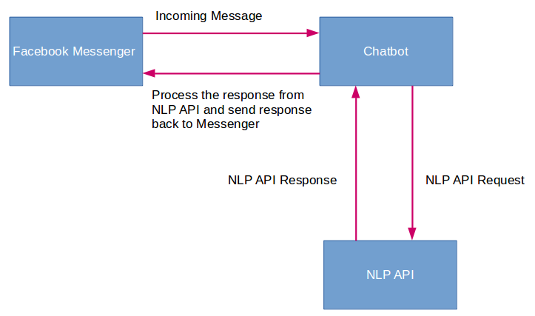
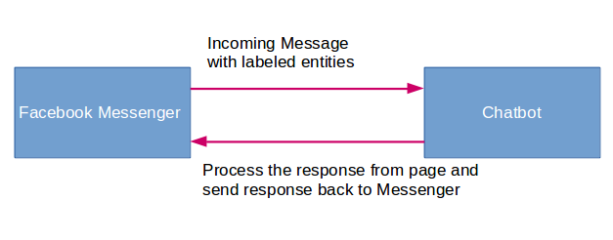
Built-in NLP
NLP
Natural Language Processing (NLP) allows you to understand and extract meaningful information out of the messages people send.
You can then use these entities to identify intent, automate some of your replies, route the conversation to a human via livechat, and collect audience data.
Built-in NLP

Slide 19
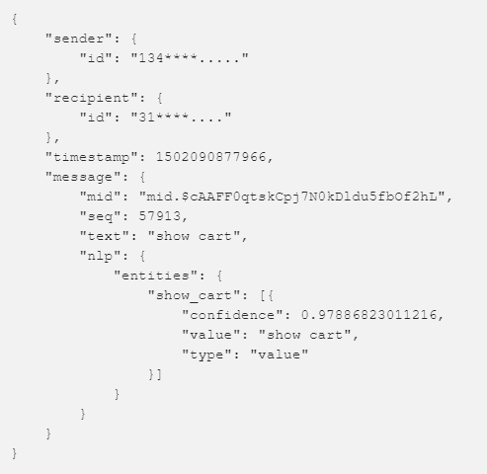
Built-in NLP
Here the “Wit.ai’ identifies the user action as ‘show user cart” and the identified entity along with its confidence value is returned with the user message.

Slide 20
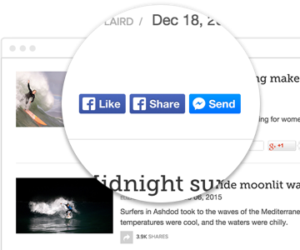
Plug-ins
The Messenger Platform provides a convenient set of web plugins that make it easy for you to start a conversation with people who visit you on the web.

Slide 21
MESSAGING
MESSAGING
Send APIs
Sending Text: To send a basic text message, submit a POST request to the Send API, with message.text set in the request body.
Sending Attachments Allow you to attach assets to your messages including: audio, video, images and files.
Standard message
Subscription message
Sponsored message

Slide 22
SUBMIT BOT
Once you have finished building your Messenger bot, you must submit it to our team for review and approval before it can be make publicly available to everyone on Messenger.
Pre-launch checklist:
Authenticity
Personalization
Notifications
Platform policies & Community Standards
To submit your bot:
Configure Your App Settings
Allow Users to Message Your Page
Select app permissions
Add Submission Details
Submit your bot
Provide Verification Information and Documents
Accept Supplemental Terms and Sign Tech Provider Agreement

Slide 23

Pros: - Own by Facebook - Free to use and available on github - Highly-customizable
Remember,
Mark knows every thing!
Cons:
- Own by Facebook
- More complicated to employ than some paid option

Slide 24
THANK YOU FOR COMING!

